Slide 1
Week6 homework

Slide 2
Description
You are now a reporter. Recently there is a murder that involves juvenile delinquency(青少年犯罪). Given a raw “input.txt” file that contains the report with the teenage name, your job is to write a program that replaces the specific words with “***” to protect the teenagers. Finally, save the revised file to another file named “output.txt”.
Input: the number of words to be replaced
the first word
the second word
…
Output: the revised report with filename “output.txt”

Slide 3
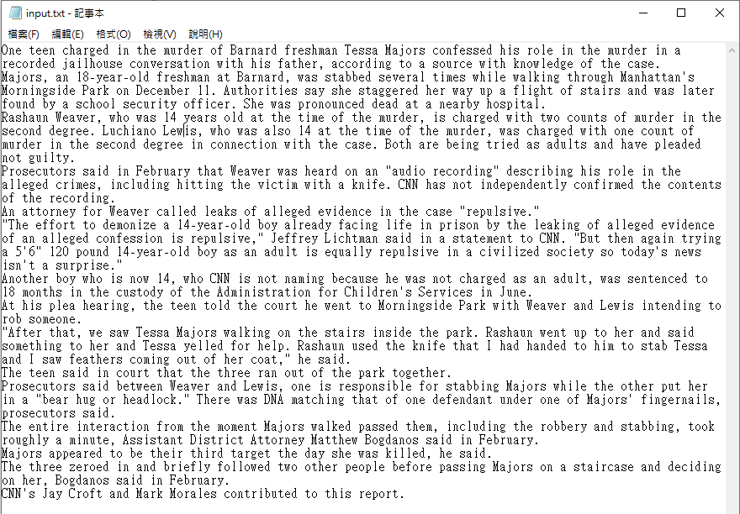

Slide 4
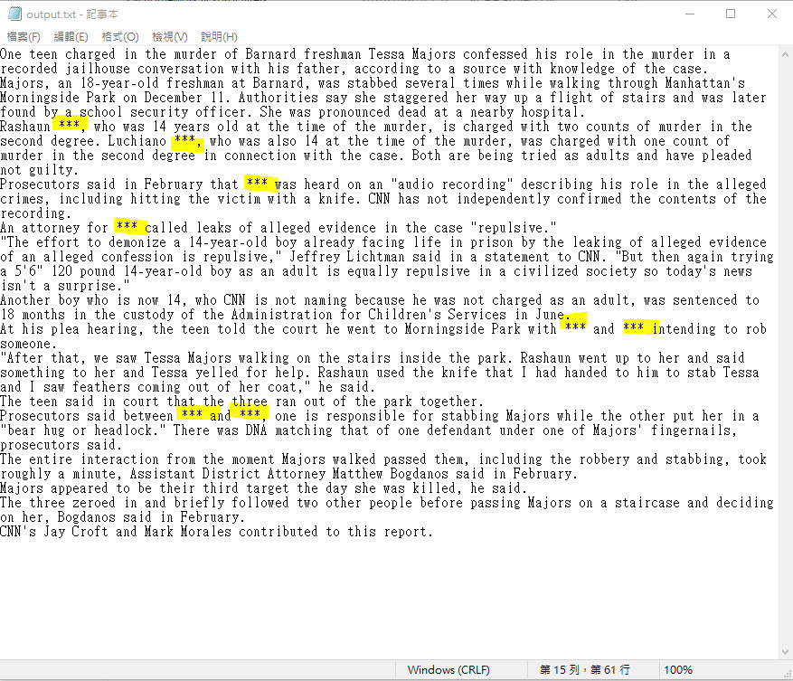
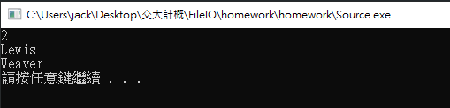

Slide 5
Note
You should not modify the “input.txt”
You only need to hand in your .cpp file
Hint: it would be easier if you use strcat(), strcmp(), strcpy(), strlen() and also watch out the ‘\0’ problem.

